Slide 1
CS 513 Knowledge Discovery and Data Mining
Prudential Life Insurance Risk Assessment

Slide 2
Team Members
Vaibhav Vashisht CWID: 10444838
Parth Parab CWID: 10444835

Slide 3
Problem Statement
The process of life insurance purchase is complicated and involves risk analysis at multiple levels and various medical exams.
Prudential wants to make the process quick less labor intensive and automated.
By using predictive modeling we are classifying the risk profiles of the customer based on their information.
https://www.kaggle.com/c/prudential-life-insurance-assessment/data
Notes:
Aryan

Slide 4
Data Set Explanation
The Data set (train.csv) has 59K Rows and 127 Columns.
The data set from Prudential has the information about customer’s personal details and their insurance preference.
The task is to classify the risk profile of the customer.
Notes:
Aryan

Slide 5
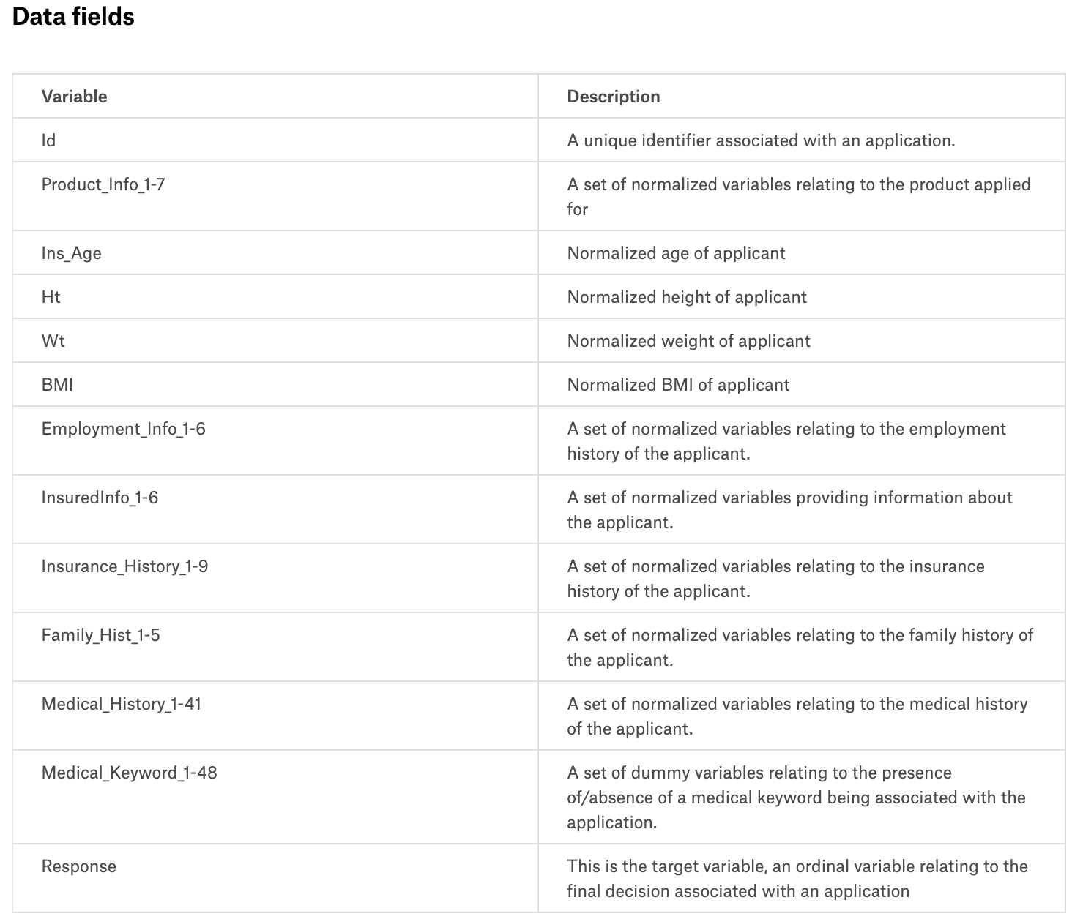
Data Set Explanation
Notes:
Aryan

Slide 6
Preprocessing
We replaced the missing entities from the data set with the column means of the data set.
We also removed specific columns based on relevance of the data
We Picked up top 75 Columns based on feature importance and missing features in training set
Notes:
Aryan

Slide 7
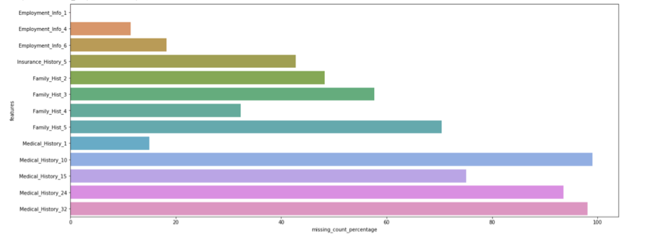
Percentage of missing feature values in the train set
Notes:
Sup

Slide 8
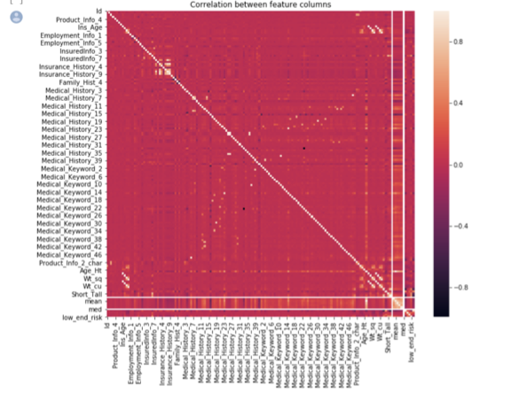
Correlation between the feature Columns
Heat map representation to show case how different features columns are correlated to each to determine the relevance.
Notes:
Aryan

Slide 9
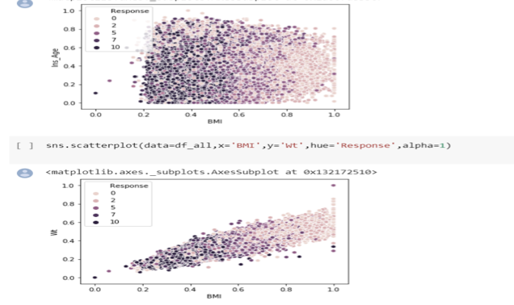
Scatter plot of key feature columns in relation to response
Notes:
Sup

Slide 10
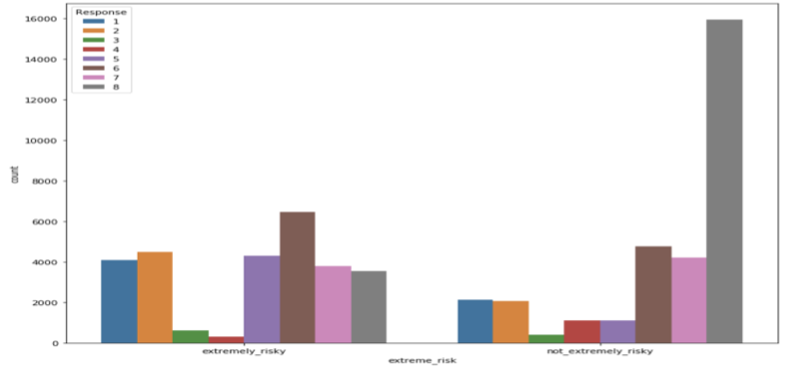
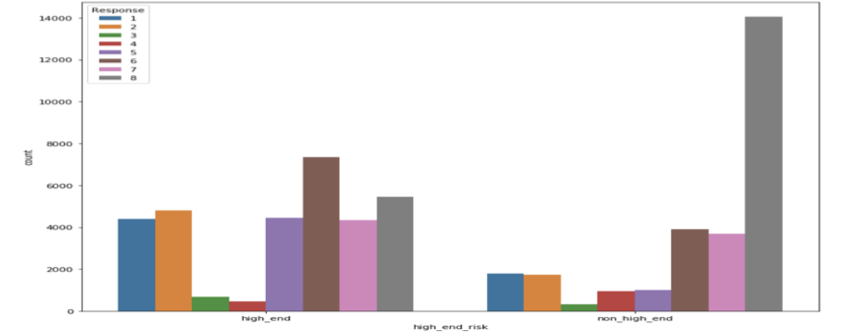
Response Profile Comparison
Based on weight
Based on age/weight/height
Notes:
Sup

Slide 11
Analysis feature label Chart using important feature selection
Notes:
sup

Slide 12
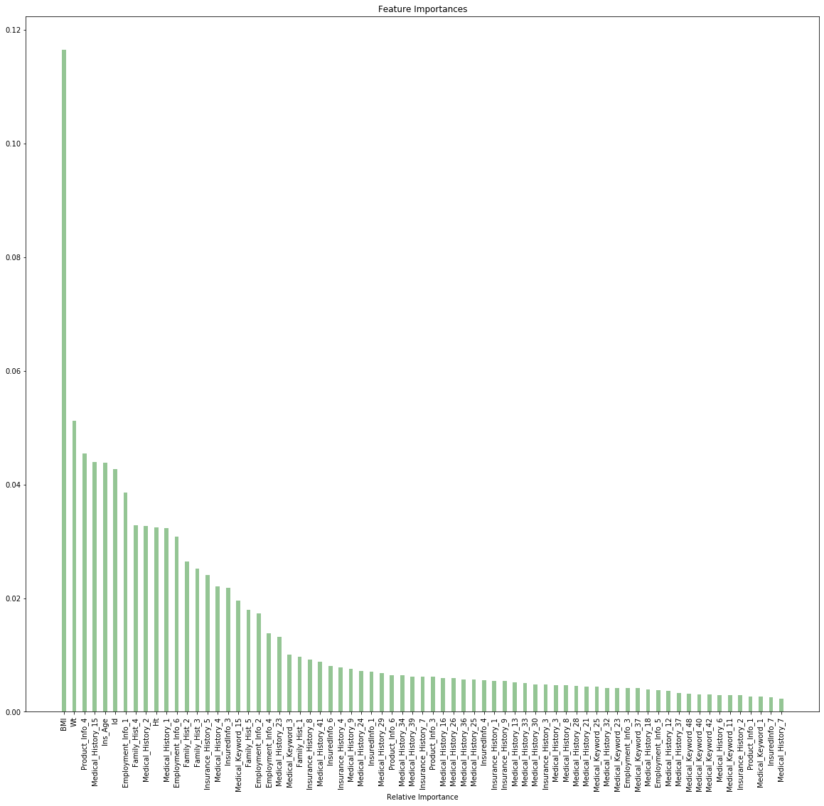
Notes:
sup

Slide 13
Classification Algorithms
BGC Classifier
Decision Tree Classifier
K-Nearest Neighbour
Multinomial Naive Bayes
Random Forest
Random Forest with Grid Search
XG Boosting
XG Boosting with Grid Search
Different classification algorithms used and their results

Slide 14
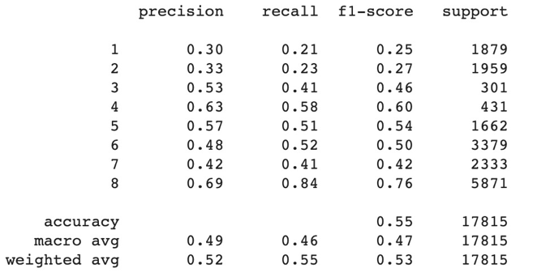
BGC Classifier
Notes:
sup

Slide 15
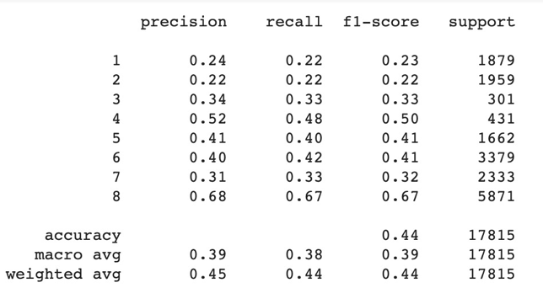
Decision Tree classifier
Notes:
p

Slide 16
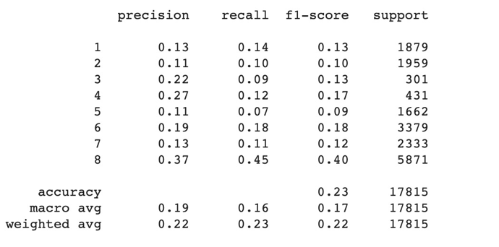
K-Nearest Neighbor classifier
Notes:
p

Slide 17
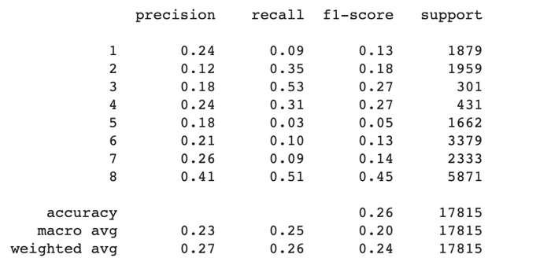
Multinomial Naïve Bayes
Notes:
p

Slide 18
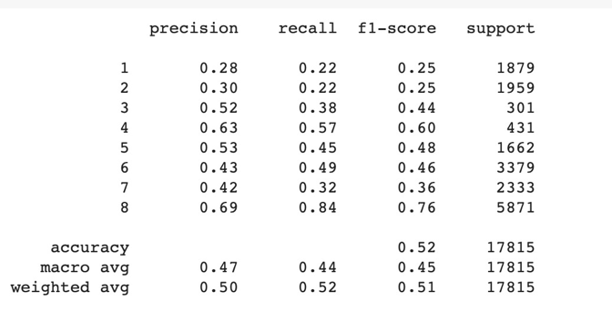
Random Forest without Grid Search
Notes:
p

Slide 19
XG Boosting without Grid Search
Notes:
p

Slide 20
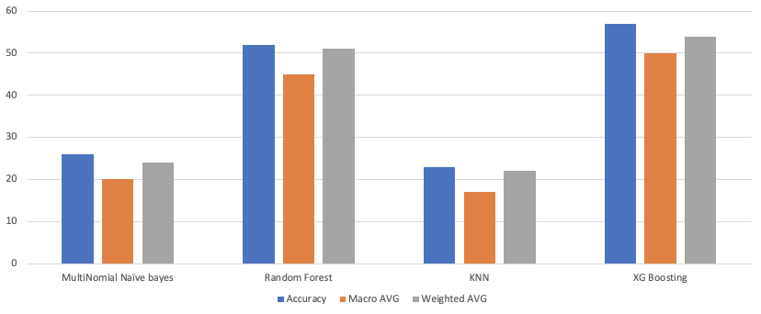
Accuracy Comparison
Notes:
p

Slide 21
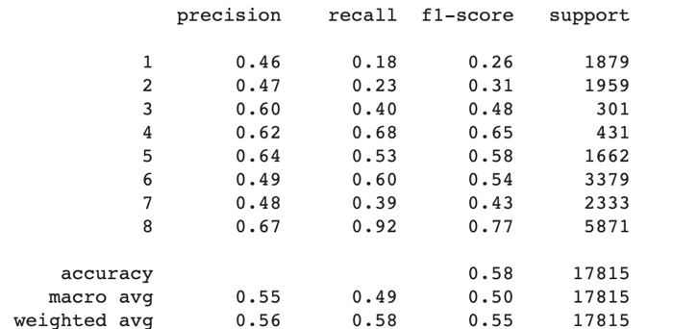
Random Forest with Hyper Parameter Boosting
Notes:
v

Slide 22
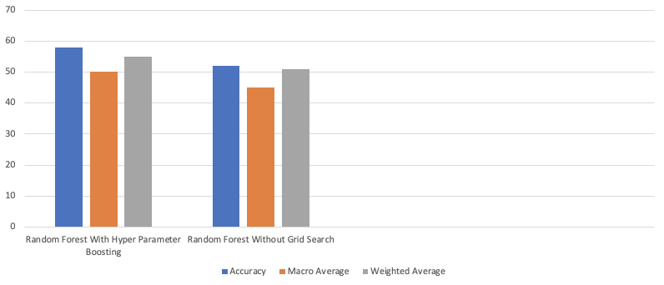
Random Forest Accuracy Comparison
Notes:
v

Slide 23
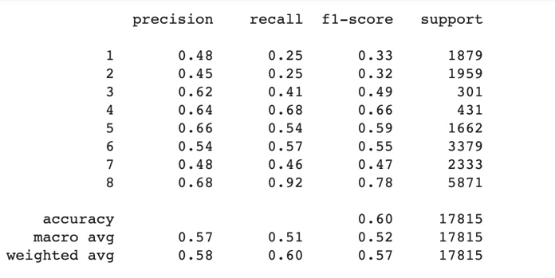
XG Boost with Grid Search
Notes:
v

Slide 24
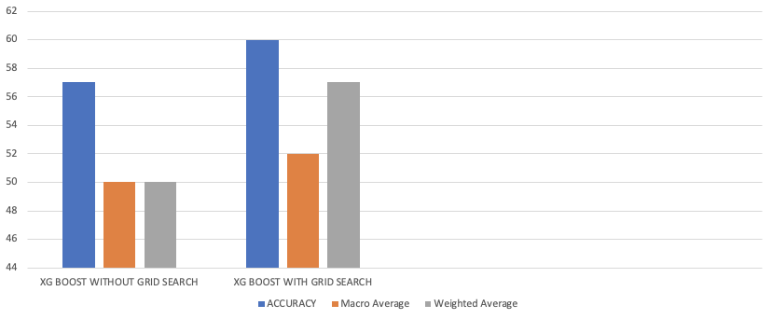
XG Boost Accuracy Comparison
Notes:
v

Slide 25
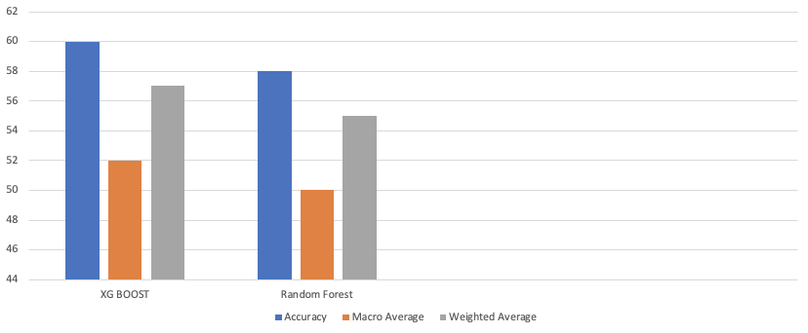
XG Boosting Vs Random Forest Using Grid Search in both the cases
Notes:
v

Slide 26
In Conclusion
Analysis
XG Boost with grid search performed well across all algorithms including xgboost without grid search
Notes:
v

